Slide 1
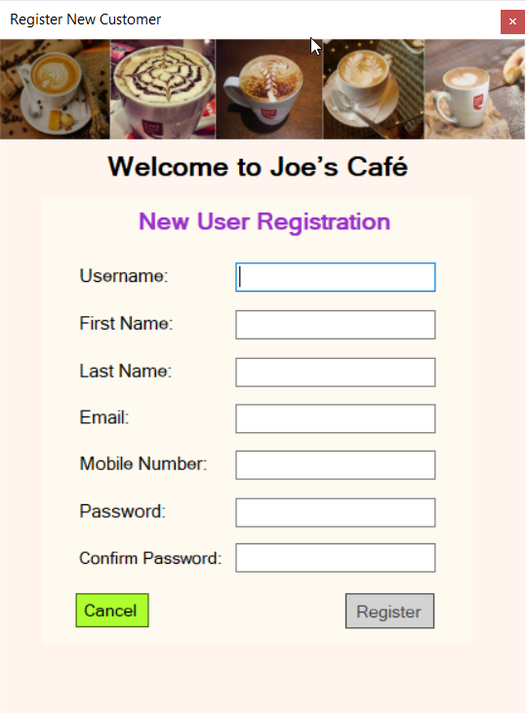
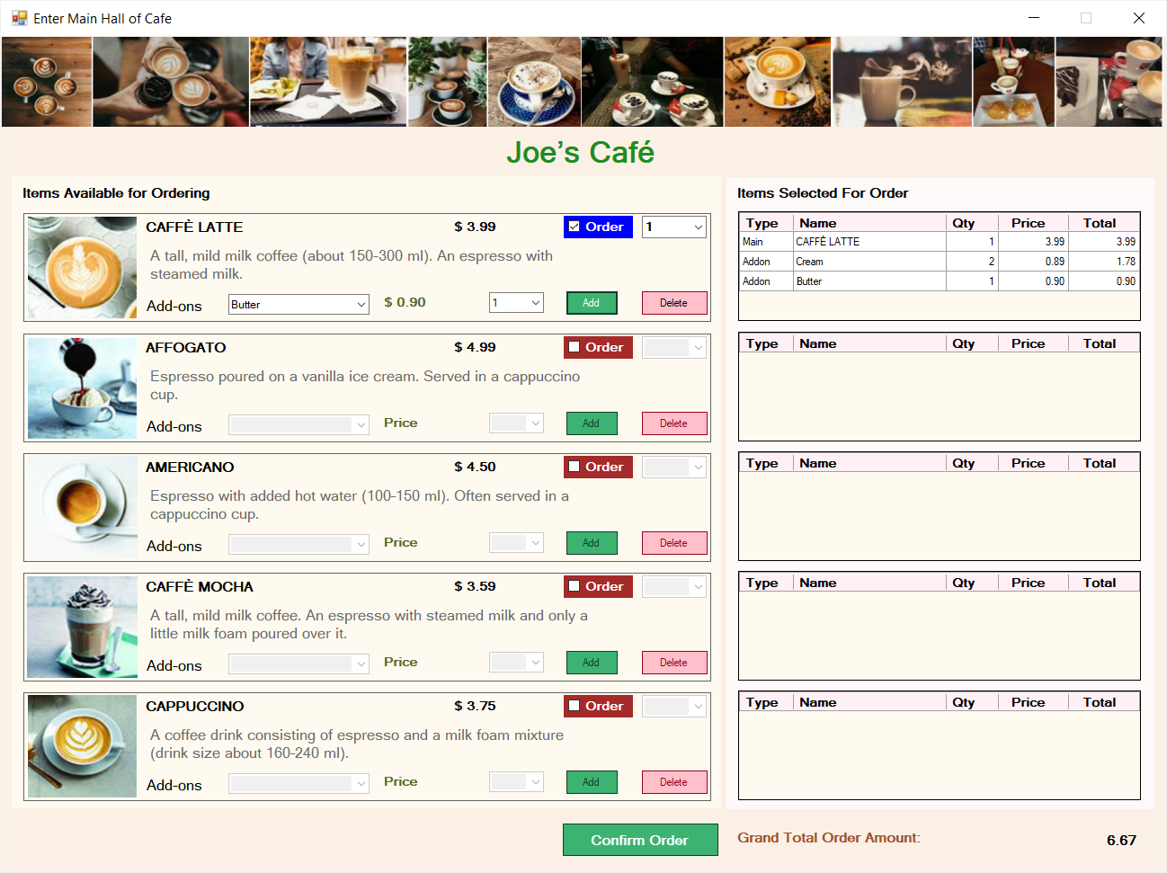
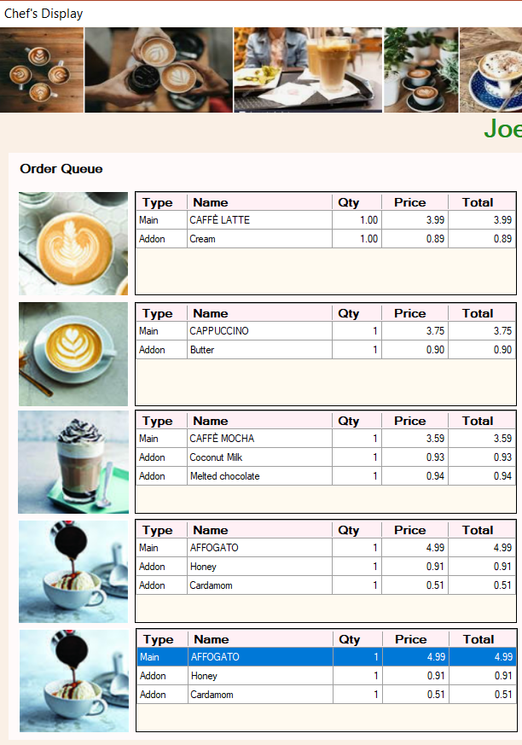
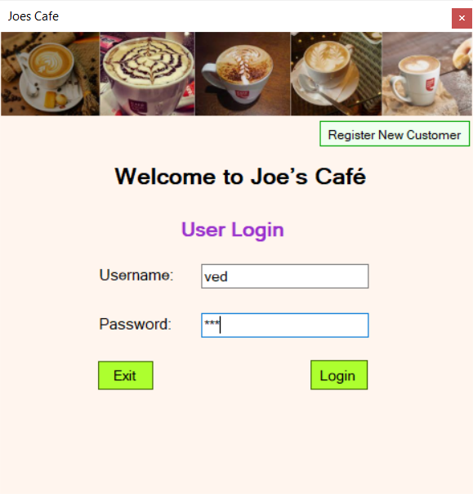
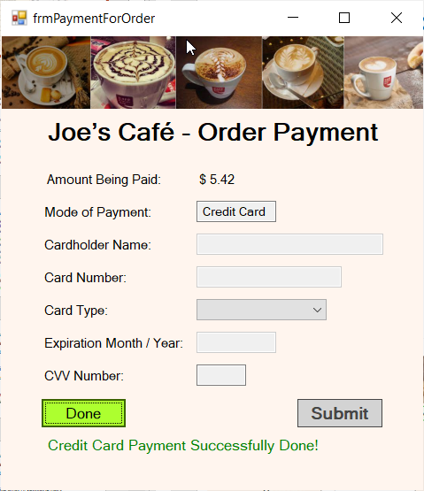
Joe’s Café Ved Chandurkar & Oreoluwa Lawal [Group 6]
Windows C# .NET Forms Application
Showcase the use of 5 Design Patterns and 5 Data Structures in a real world scenario

Slide 2
Joe’s Café
The Application
This “Joe’s Café” application would be a C# .Net application that would cater to ordering the different beverages and dishes available in a typical coffee shop.
Graphical User Interface for this application written as a C# .NET Forms, which will have several forms to serve the needs of the Joe’s Café.
In the code of this C# .Net application we showcase following 5 design patterns.
The class that sells out the different beverage products like Coffee & Tea, does give us an ample scope in creating the above-mentioned design patterns.
This Joe’s Café application is not too complex and not trivial either. This helps set up a perfect stage to demonstrate the use of five design patterns and five data structures in the real world.

Slide 3
Joe’s Café
Following Design Patterns are used in the application
Singleton – BeverageDisplayRecordFactory which gives out the instances of the BeveragePanel prototype objects. This is required to be a single instance that can server the whole application.
Factory Method – BeverageDisplayRecordFactory that gives out the group of form controls that has to be staged for the Coffee Ordering form
Prototype – The instances of BeveragePanelPrototype class are a group of dynamically created form controls (like labels, checkboxes, drop downs, buttons, images) that have to be made again an again and are made by cloning the prototype instance.
Observer – The Grand Total label, is an observer object that observes the subject which is the form controls that could change the cost of a coffee order.
Iterator – Finally the Pattern that everyone uses to loop over the aggregate values.

Slide 4
Joe’s Café
Following Data Structures are used in the application
List – Typed Array List class - growing array equivalent, that supports Generics
Dictionary – Associative array of key-value pairs
Sorted Dictionary – Associative array that orders the stored objects on the Key
Tuple – A structure that holds multiple values together. Has access methods for retrieving the fields.
Queue – Data Structure that implements First in First out (FIFO) access.

Slide 5
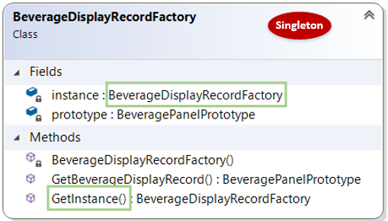
Joe’s Café
Singleton Design Pattern
BeverageDisplayRecordFactory class is a single class.
It is having a private static ‘instance’ variable.
The clients have to call the GetInstance() method to retrieve the single instance of this class.
The instance is created the first time the client calls the GetInstance() method – Delayed initialization.

Slide 6
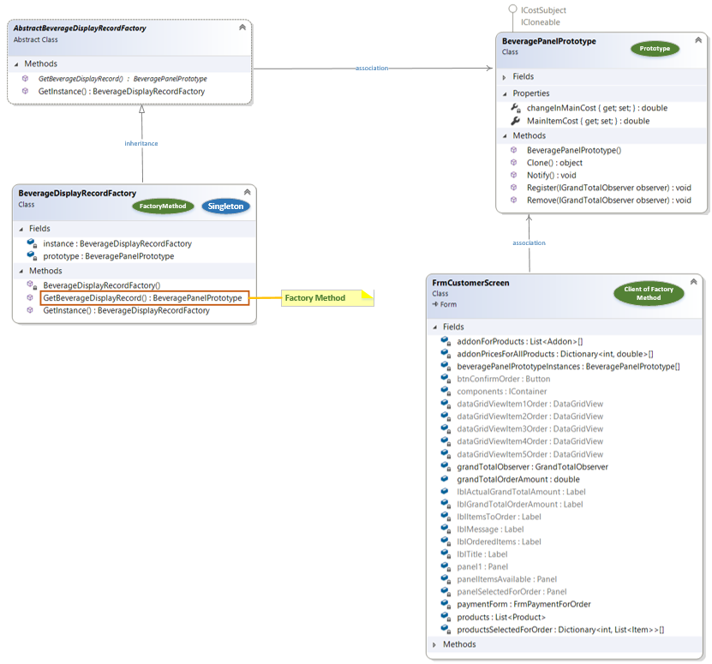
Joe’s Café
Factory Method & Prototype Design Patterns
BeverageDisplayRecordFactory is a single class
BeverageDisplayRecordFactory implements a factory method ‘GetBeverageDisplayRecord’.
GetBeverageDisplayRecord method returns the BeverageDisplayRecord cloned from the prototype.
‘FrmCustomerScreen’ form instance is a client for this factory method.
Factory method uses BeveragePanelPrototype to clone the new instance that will be returned.

Slide 7
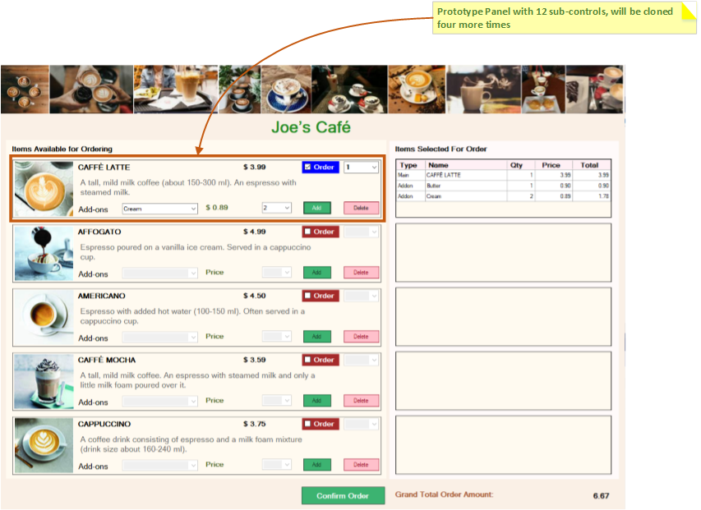
Joe’s Café
Some more details on Prototype Design Patterns

Slide 8
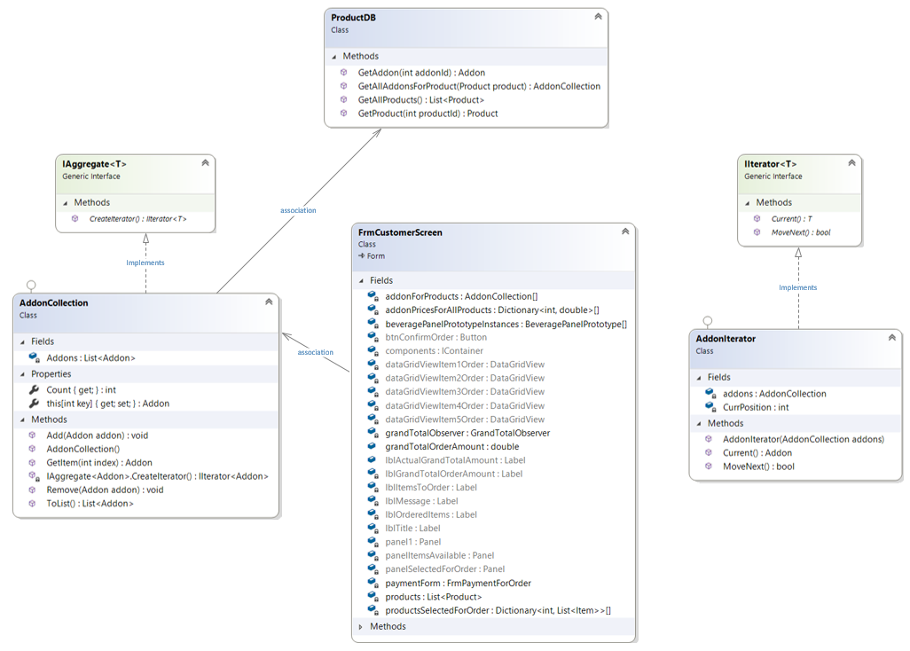
Joe’s Café
Iterator Design Pattern
The AddonIterator implements IIterator interface
AddonCollection implements IAggregate interface
ProductDB and FrmCustomerScreen classes are clients of these two.

Slide 9
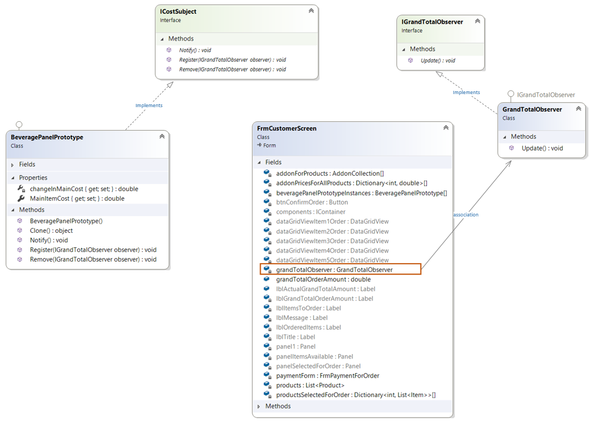
Joe’s Café
Observer Design Pattern
The control elements in BeveragePanelPrototype affect the total cost (Grand Total)). Hence BeveragePanelPrototype becomes the Observed (Subject).
On the other side GrandTotalObserver class is the Observer.
When the elements that affect the total cost change, the Subject calls the Notify() and the Grand Total on the screen gets updated.

Slide 10
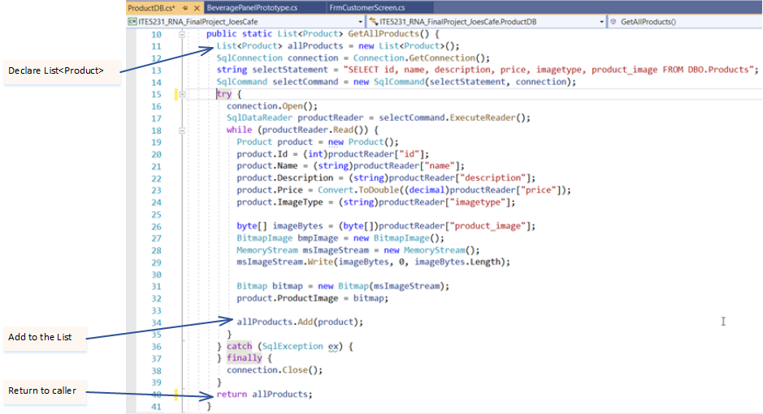
Joe’s Café
List<Type> Data Structure

Slide 11
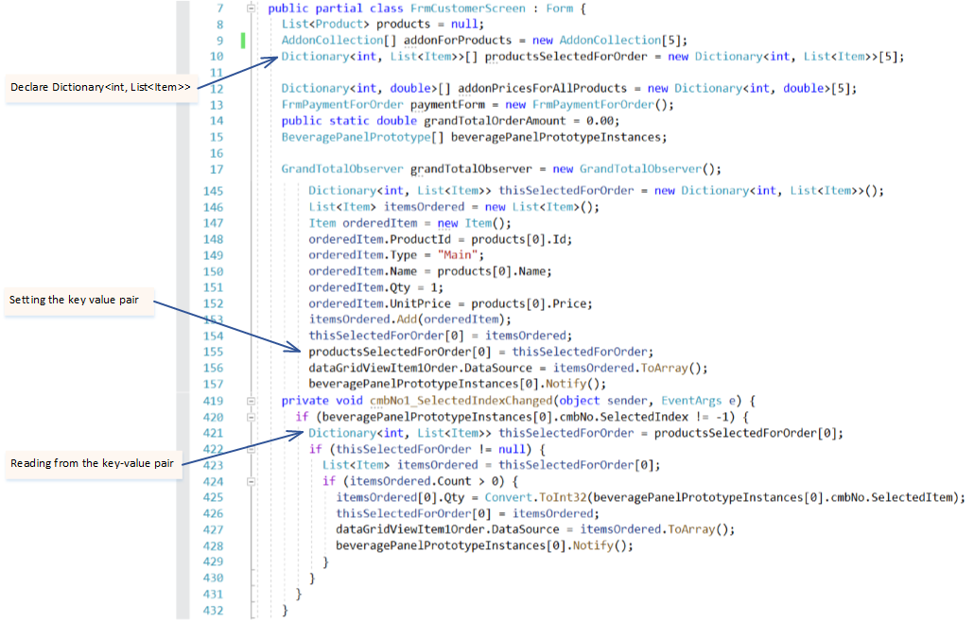
Joe’s Café
Dictionary<K, V> Data Structure

Slide 12
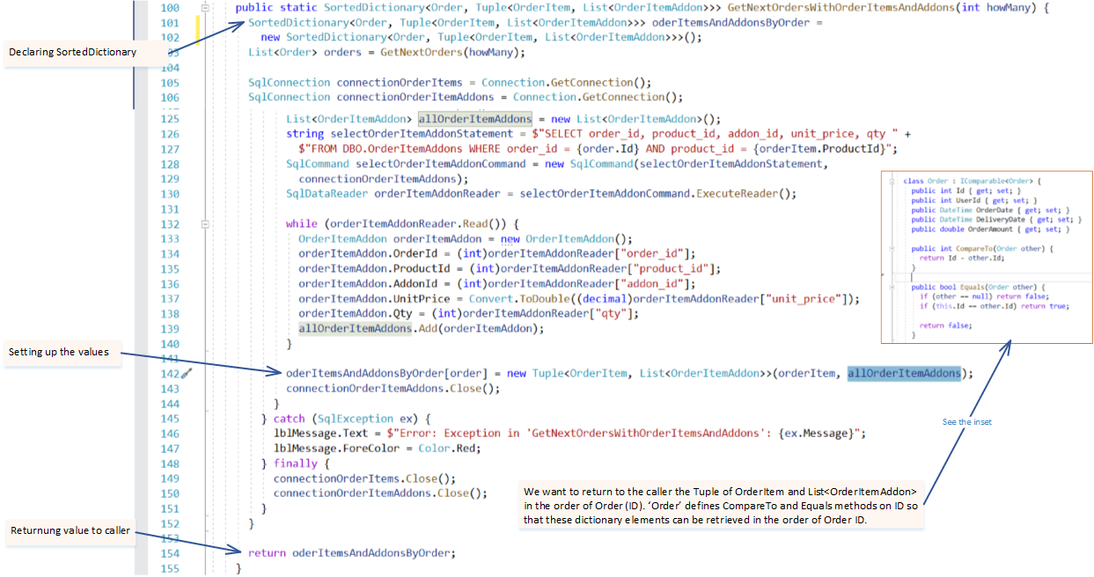
Joe’s Café
SortedDictionary<K, V> and Tuple Data Structures

Slide 13
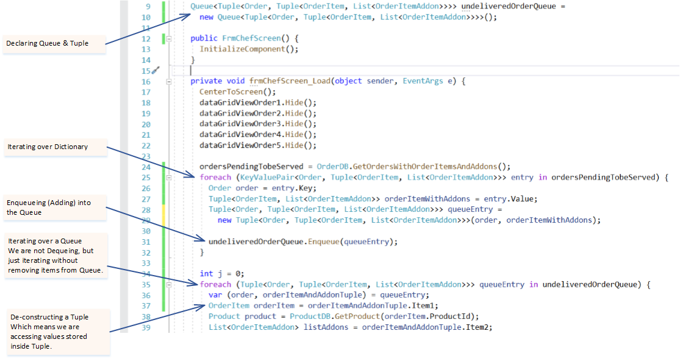
Joe’s Café
Queue and Tuple Data Structures

